Slide 1
STUDENT ENROLMENT DATA INTEGRATION SOLUTION Azure Integration Developer Technical Assessment University of Portsmouth - Library and Information Services Presenter: Mohammad Kafee Uddin

Slide 2
Business Problem & Requirements
The Challenge
Scenario:
External Admissions System exports student enrolment data
Data format incompatible with University's Student Information System (SIS)
Data quality issues present (missing fields, duplicates, invalid values)
Requirements:
Read and validate incoming data
Transform to SIS format
Handle data quality issues gracefully
Service Bus as architectural boundary
Clear exception reporting for support teams
Testable and auditable solution
Key Challenge: Process data reliably while catching and reporting errors clearly for operations team

Slide 3
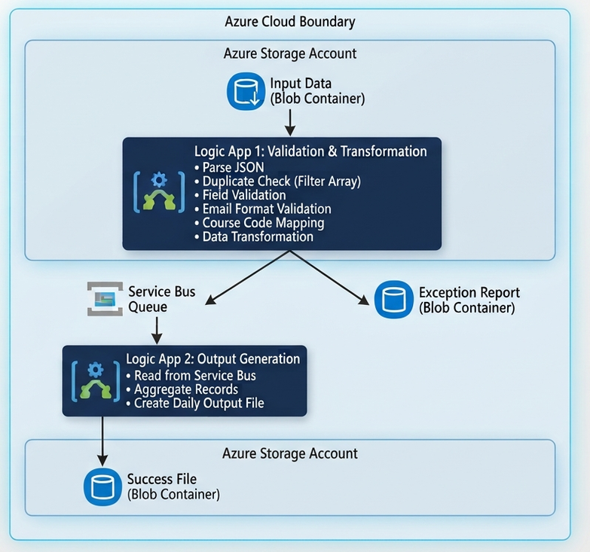
High-Level Design

Slide 4
Azure Services Used
Technology Stack
Service | Purpose | Why Chosen
Azure Logic Apps (2x) | Orchestration & transformation | Low-code, built-in connectors, visual workflow
Azure Service Bus Queue | Architectural boundary | Decouples transformation from output, reliable messaging
Azure Blob Storage | Data storage | Cost-effective, simple file storage for input/output
HTTP Trigger | Testing interface | Easy manual testing during development
Design Principles
Separation of Concerns - Two Logic Apps with clear responsibilities
Fail-Fast Validation - Invalid data never reaches Service Bus
Sequential Processing - Prevents duplicate detection race conditions
Clear Error Messages - Support staff can understand failures without code review

Slide 5
Data Transformation Logic
Source to Target Mapping
Source Field | Target Field | Transformation
student_id | studentNumber | Direct mapping
forename + surname | fullName | Concatenate with space
email_address | email | Direct mapping
course | courseCode | Lookup translation
N/A | status | Always "Active"
Course Code Translation
{
"BSc Computer Science": "BCS",
"BSc Business Studies": "BBS",
"BSc Psychology": "BPS"
}
Input:
{
"student_id": "10001",
"forename": "Jane",
"surname": "Smith",
"course": "BSc Computer Science",
"email_address": "j.smith@uni.ac.uk"
}
Output:
{
"studentNumber": "10001",
"fullName": "Jane Smith",
"courseCode": "BCS",
"email": "j.smith@uni.ac.uk",
"status": "Active"
}

Slide 6
Validation & Exception Handling
Multi-Layer Validation Strategy
1. Duplicate Detection
Filter Array checks if student_id already processed
Sequential processing prevents race conditions
First occurrence wins
2. Mandatory Field Validation
student_id, forename, surname, email_address
Empty strings treated as missing
3. Email Format Validation
Must contain '@' character
Must contain '.' after '@'
Basic format check (not full regex)
4. Course Mapping Validation
Course name must exactly match mapping table
No fuzzy matching or abbreviations
Exception Handling Approach
Fail-Fast: Invalid records never reach Service Bus Detailed Logging: Each error includes original data + reason Operational Support: Clear error messages for non-technical staff Audit Trail: All errors in timestamped JSON file
Error Report Example:
{
"student_id": "10011",
"forename": "Sarah",
"surname": "Green",
"course": "BSc Comp Sci",
"email_address": "s.green@uni.ac.uk",
"reason": "Unknown course mapping: BSc Comp Sci",
"timestamp": "2026-09-01T21:21:11Z"
}

Slide 7
Data Quality Issues Found
Sample Dataset Analysis: 14 Records
10 Valid Records - Successfully transformed and sent to Service Bus
4 Invalid Records:
Handling Decisions
Exact Matching: Course names must match exactly - no abbreviations accepted Duplicate Strategy: First occurrence processed, subsequent duplicates rejected Empty vs Missing: Both treated as validation failures
Student ID | Name | Issue | Reason
10011 | Sarah Green | Unknown Course | "BSc Comp Sci" ≠ "BSc Computer Science"
10012 | Ava Walker | Missing Data | Email address is empty string
10013 | Mitchell | Missing Data | Forename field is empty
10004 | David Turner | Duplicate | student_id already processed (Daniel Taylor)

Slide 8
Testing Evidence & Results
Test Scenarios Executed
Test Case | Input | Expected Result | Actual Result
Valid Record | Student 10001 (Jane Smith) | Transformed & sent to Service Bus | Pass
Missing Field | Student 10013 (no forename) | Rejected with clear error | Pass
Invalid Data | Student 10011 (wrong course) | Rejected with clear error | Pass
Duplicate ID | Student 10004 (appears twice) | First accepted, second rejected | Pass
Empty Email | Student 10012 (empty email) | Rejected with clear error | Pass
Full Dataset | All 14 records | 10 success, 4 failures | Pass
Processing Summary:
{
"totalRecords": "14",
"successfulRecords": "10",
"failedRecords": "4",
"processingTimestamp": "2026-09-01T21:21:11Z"
}
Verification Methods
Logic App Run History - All 14 iterations visible Service Bus Queue - 10 messages sent and consumed Success Blob - Contains 10 transformed records Exception Blob - Contains 4 error records with reasons

Slide 9
Key Assumptions & Design Decisions
Assumptions Made
Course Mapping: Exact match required - no fuzzy matching
Duplicate Handling: First occurrence wins (not last, not merge)
Email Validation: Basic format check sufficient (contains '@' and '.')
All Fields Mandatory: Even though schema allows nulls
Status Field: Always "Active" for all successful records
Sequential Processing: Prioritized reliability over speed
Design Decisions & Justifications
Why Service Bus Queue (not Topic/Subscription)?
Single consumer scenario (Logic App 2)
Simpler to configure and demonstrate
Meets architectural boundary requirement
Why Sequential Processing?
Prevents duplicate detection race conditions
More reliable than parallel with shared state
Performance acceptable for this use case
Why In-Memory Duplicate Check (not Table Storage)?
Simpler implementation for assessment scope
Sufficient for batch processing per file
Table Storage could be added for cross-file persistence
Why Filter Array for Duplicate Check?
More reliable than string contains()
Clear and explicit logic
Easy to debug in run history

Slide 10
Live Demonstration

Slide 11
Solution Highlights & Achievements
What Was Delivered
Fully Functional Integration - Processes all 14 test records correctly
Service Bus Boundary - Clean separation of transformation and output
Comprehensive Validation - Multiple layers catching all issues
Clear Error Reporting - Support-friendly exception messages
Duplicate Detection - Sequential processing prevents race conditions
Testing Evidence - All required test scenarios passed
Technical Achievements
Duplicate Detection Challenge:
Solved race condition with sequential processing
Used Filter Array for reliable ID checking
Added IDs immediately after duplicate check
Error Message Quality:
Each error includes original data for context
Specific reason for failure
Timestamp for audit trail
No need to review code to understand failures
Architectural Boundary:
Service Bus provides clean separation
Transformation failures don't affect output logic
Easy to scale or modify each stage independently

Slide 12
Future Enhancements
Production-Ready Improvements
1. Enhanced Validation
Full regex email validation
Student ID format validation (e.g., must be 5 digits)
JSON Schema validation at input
2. Persistent Duplicate Tracking
Azure Table Storage for cross-file duplicate detection
Track all processed IDs permanently
Handle re-submissions gracefully
3. Advanced Monitoring
Application Insights integration
Custom telemetry events
Alerting on high error rates
Azure Dashboard with metrics
4. Retry & Error Handling
Dead Letter Queue for poison messages
Exponential backoff retry policy
Circuit breaker pattern for downstream failures
5. Performance Optimization
Parallel processing with proper locking
Batch Service Bus sends
Optimize Filter Array with indexed lookups
6. Security Enhancements
Managed Identity for connections
Key Vault for connection strings
Encryption at rest and in transit
7. Additional Features
Email notifications on failures
Automatic data correction suggestions
Support for partial batch failures
Versioning of transformation rules

